Slide 1
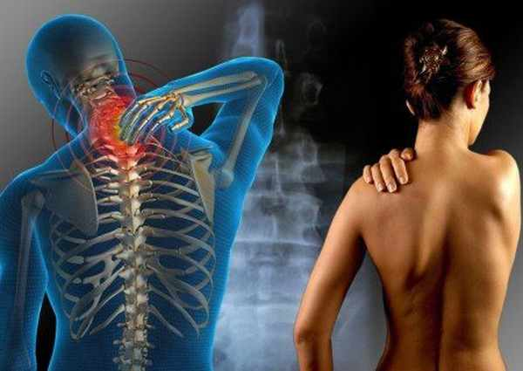
Fibromyalgia and MEFV
Marie Kumerow
http://lakescenterchiro.com/wp-content/uploads/2011/10/fibromyalgia41.jpg

Slide 2
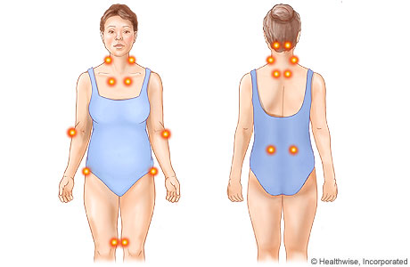
What characterizes fibromyalgia?
Symptoms
Musculoskeletal pain, fatigue, pressure points, depression
Prevalence
2% general population affected
85% cases are in women
“…may be due to injury, emotional distress, or viruses that change the way the brain perceives pain, but the exact cause is unclear.” -FDA, 2008

Slide 3
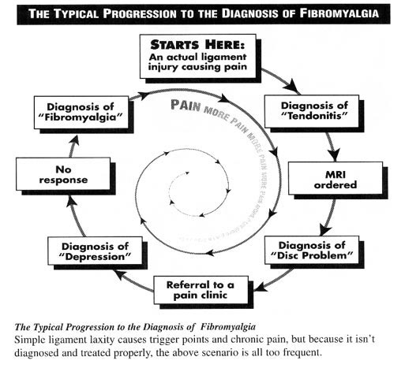
Diagnosis of Fibromyalgia
http://3.bp.blogspot.com/-LmxBPOFj7_I/UVHpB6wrvtI/AAAAAAAAAkM/2g_oHC_RuUk/s1600/fibromyalgia+progression.png

Slide 4
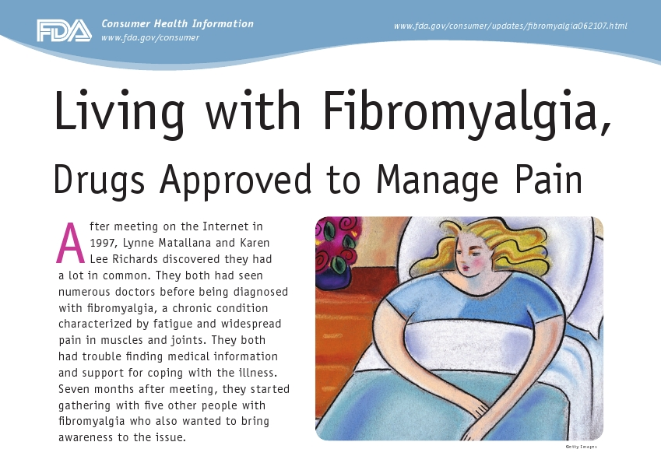
Drug Treatments
2007
2008
2009
http://www.sandmedia.com/what/examples/PfizerLyrica_sm/PfizerLyrica_sm-poster.jpg
http://www.fogmagazine.com/wp-content/uploads/2008/07/simba.jpg
http://www.hopkinsarthritis.org/wp-content/uploads/2011/04/savella.gif
Notes:
Lyrica (pregabalin): Lyrica is a nerve pain and epilepsy drug
Cymbalta (duloxetine): a type of antidepressant called a serotonin and norepinephrine reuptake inhibitor (SNRI).
Savella – also SNRI

Slide 5
Alternative Treatments
Massage, acupuncture, chiropractics, exercise programs, weight loss, herbal medicines and dietary supplements
Vegetarian or vegan diet
http://manageyourfibro.com/wp-content/uploads/2013/01/Fibromyalgia-Alternative-Treatment.jpg

Slide 6
Fibromyalgia correlated to MEFV Gene
PYRIN
BBOX
CC
PRY
SPRY
“Mediterranean fever” gene named for association with Familial Mediterranean Fever Syndrome (FMF).
FMF symptoms include intense joint attacks, abdominal pain, pleura and pericardium inflammation, and fever.

Slide 7
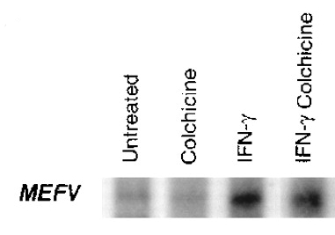
MEFV Gene inhibits inflammatory response genes
PYRIN
BBOX
CC
PRY
SPRY
ASC
actin
IL-1beta
PSTPIP1
Caspase-1
PSTPIP1
MEFV
ASC
Caspase-1
IL-1β
IL-1β
Inflammasome
Centola et al. 2000

Slide 8
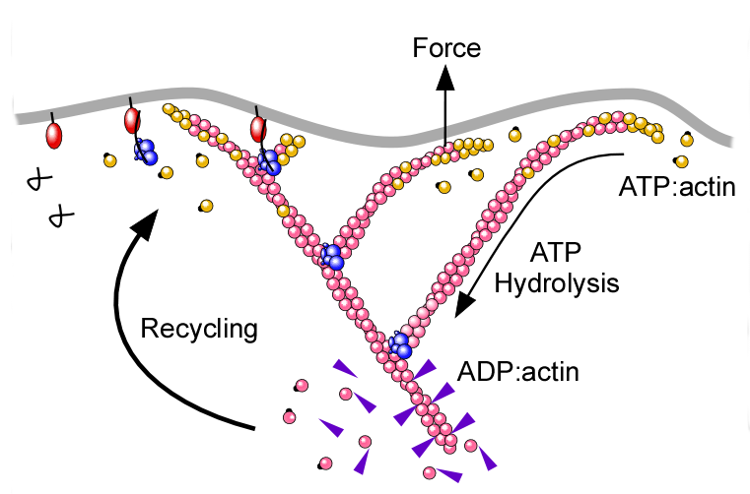
Where does MEFV protein bind actin?
PYRIN
BBOX
CC
PRY
SPRY
ASC
actin
IL-1beta
PSTPIP1
Caspase-1
Mansfield et al. 2001

Slide 9
Actin binding domain is well conserved
Human
Dog
Mouse
Rat
Fish
Frog
Worm
Fly
Plant
MEFV
MEFV
MEFV
MEFV
BTY
TRIM39
Arc-1
CG6071
PPR
B
781
B
580
B
767
B
750
B
554
B
554
B
543
962
257
Notes:
MEFV - FMF, marenostrin, pyrin, TRIM20
Mouse chromosome 16
BTY – eurythrocyte differentiation, zinc-binding (an RBCC/TRIM)
TRIM 39 – ubiquination, zinc-binding
E3 ubiquitin-protein ligase arc-1
PPR – mitochondrion, transferase activity

Slide 10
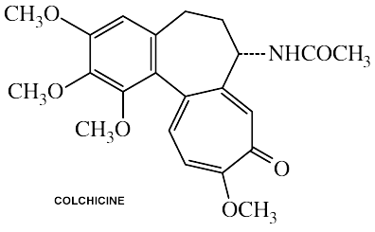
How can you target actin?
Small molecule colchicine activates actin polymerization by microtubule depolymerization
Used as a drug in Familial Mediterranean Fever and Gout

Slide 11
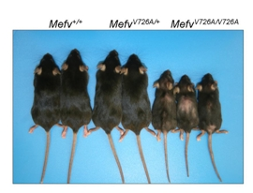
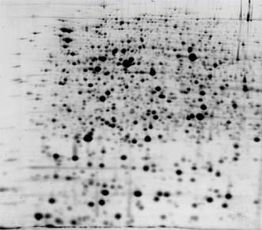
Hypothesis
Colchicine will show decreased levels of interleukin inflammatory response relative to SNRI treatment.
Che et al. 2003

Slide 12
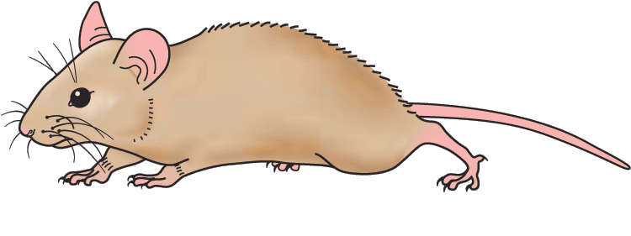
How does colchicine affect fibromyalgia?
Is SNRI or colchicine more effective treatment?
MEFV ^{+/+} Mouse
w/ colchichine
MEFV ^{-/-} Mouse w/ colchicine
MEFV ^{-/-} Mouse w/ SNRI
MEFV ^{+/+} Mouse
MEFV ^{-/-} Mouse
http://bestclipartblog.com/clipart-pics/mouse-clipart-5.gif

Slide 13
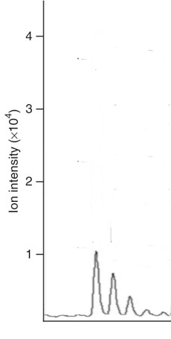
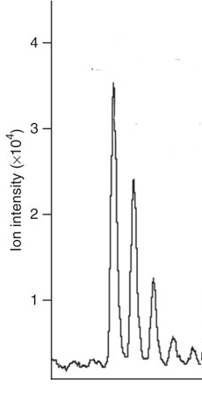
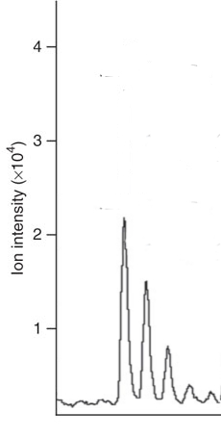
Levels of active IL-1 are lower in colchicine treatment
MEFV ^{+/+} Mouse
w/ colchichine
MEFV ^{-/-} Mouse w/ colchicine
MEFV ^{-/-} Mouse w/ SNRI
MEFV ^{+/+} Mouse
MEFV ^{-/-} Mouse
IL-1
IL-1
IL-1
IL-1
IL-1
IL-1
IL-1
IL-1
IL-1
IL-1
MEFV
MEFV
MEFV
MEFV
MEFV

Slide 14
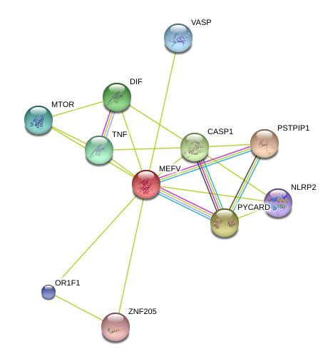
Conservation of protein interaction
http://www.bioinf.uni-leipzig.de/Publications/SUPPLEMENTS/04-014/zebrafish.png

Slide 15
What is PSTPIP1?
Scaffold protein and regulator of actin cytoskeleton
Known interactor with MEFV
PAPA syndrome
FCH
C C
LCR
SH3
418 aa
MEFV
MEFV

Slide 16
How does PSTPIP1 interact with MEFV protein?
Mutations in PSTPIP1 protein create a dominant negative affect on the predicted inhibition by MEFV protein.
P
P
P
PSTPIP1
MEFV
ASC
Caspase-1
IL-1β
IL-1β
Inflammasome

Slide 17
Vegetarianism and inflammatory response
Vegetarian diets
Rich in antioxidants
Low fat
Studies on fibromyalgia and diet have shown decreased BMI associated with reduced symptoms.
IL-18 was associated with obesity.
http://musclebuildingprogramreviewed.com/wp-content/uploads/2011/04/vegetarian-muscle-building-diet.jpg

Slide 18
Hypothesis
Providing a low fat diet will reduce inflammatory response in mice with PSTPIP1 mutations.
http://musclebuildingprogramreviewed.com/wp-content/uploads/2011/04/vegetarian-muscle-building-diet.jpg

Slide 19
How can a low fat diet alter autoinflammation?
PSTPIP1 ^{+/+} Mouse
Low fat diet
PSTPIP1 ^{-/-} Mouse Low fat diet
PTSPIP1 ^{+/+} Mouse
PSTPIP1 ^{-/-} Mouse
http://bestclipartblog.com/clipart-pics/mouse-clipart-5.gif

Slide 20
A low fat diet decreases inflammatory response
PSTPIP1 ^{+/+} Mouse
Low fat diet
PSTPIP1 ^{-/-} Mouse Low fat diet
PTSPIP1 ^{+/+} Mouse
PSTPIP1 ^{-/-} Mouse
IL-1
IL-1
IL-1
IL-1
IL-1
IL-1
IL-1
IL-1
MEFV
MEFV
MEFV
MEFV

Slide 21
Conclusions
Colchicine treatment is likely to be effective in treatment of human fibromyalgia, where cytokines levels are high.
A low fat, vegetarian diet should reduce inflammatory symptoms in fibromyalgia and other autoinflammatory diseases, including PAPA syndrome.

Slide 22
Future Research
More studies regarding whether being overweight is a symptom or cause of fibromyalgia.
Human drug trials of colchicine for fibromyalgia.
Global patterns of fibromyalgia – high rate of MEFV carriers from the Mediterranean Sea.

